Slide 1

Flappy Bird 2: A Game Development Journey
Welcome to Flappy Bird 2! This presentation explores the steps involved in creating a fun and challenging game based on the classic Flappy Bird concept.

Slide 2
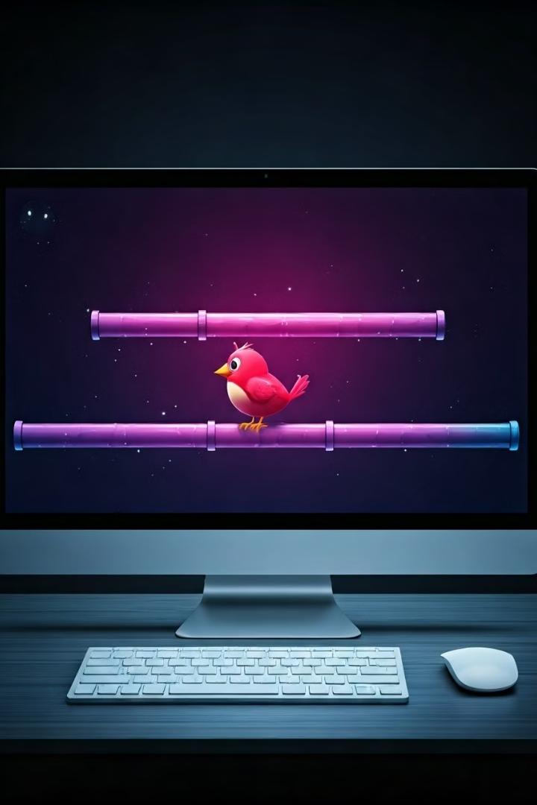
Game Setup and Initialization
1
Initialize Game Window
Create a new JFrame to serve as the main window for the game.
2
Set Window Dimensions
Define the width and height of the game window, ensuring a suitable aspect ratio for optimal gameplay.
3
Add Game Panel
Instantiate a JPanel to hold and display the game elements, such as the bird, pipes, and background.
4
Add Event Listeners
Attach event listeners to the game panel to handle user input, such as keyboard presses for bird control.

Slide 3

Importing Necessary Libraries
1
java.awt.*
2
java.awt.event.*
Provides classes for creating and manipulating graphical elements like shapes, colors, and fonts.
Offers classes for handling events like mouse clicks, key presses, and window resizing.
3
java.util.ArrayList
4
javax.swing.*
A dynamic list for efficiently storing and managing collections of objects like pipes.
Extends the AWT library with components like buttons, labels, and text fields for creating a more interactive user interface.

Slide 4
Defining Game Board Dimensions
boardWidth
boardHeight
Sets the horizontal width of the game board, affecting the size of the game world.
Specifies the vertical height of the game board, determining the overall size of the game area.

Slide 5
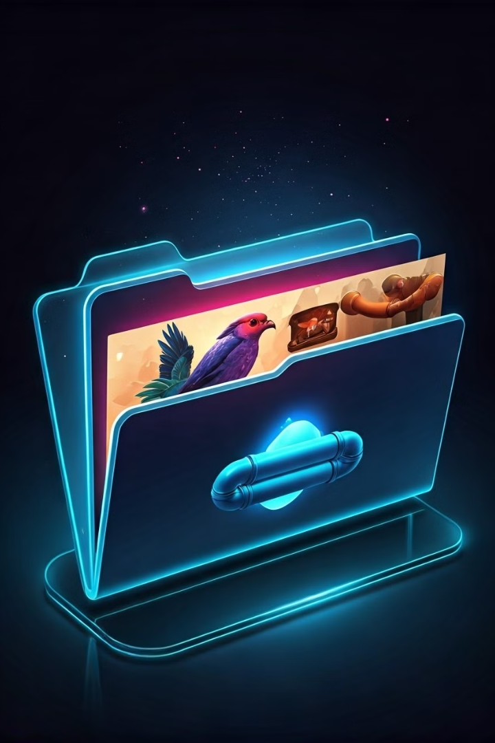
Loading and Handling Game Assets
Image Type
Description
Purpose
backgroundImg
A static background image for the game.
Provides a visual backdrop for the gameplay.
advancedBackgroundImg
A more complex background image for higher levels.
Increases visual complexity and difficulty.
level3BackgroundImg
A unique background image for a special level.
Offers a distinct visual experience for a specific level.
birdImg
Image of the bird, which will be animated in the game.
Represents the player-controlled character.
topPipeImg
Image of the upper half of the pipe obstacle.
Creates the upper part of a pipe opening.
bottomPipeImg
Image of the lower half of the pipe obstacle.
Creates the lower part of a pipe opening.
spikeImg
Image of a spike obstacle, adding a new challenge.
Introduces a different type of obstacle for the player to avoid.

Slide 6
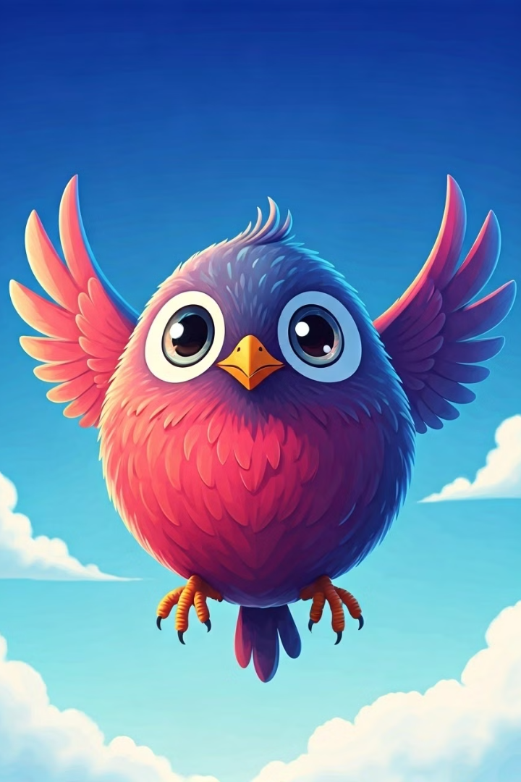
Implementing the Bird Class
Bird Attributes
Flap Method
Include properties like position, velocity, and flap strength to control the bird's movement.
Implement a method to apply an upward force to the bird when the player presses the space bar.
Gravity
Collision Detection
Simulate gravity by applying a downward force to the bird, pulling it back down towards the ground.
Implement a method to check if the bird collides with the pipes or the ground, ending the game if a collision occurs.

Slide 7
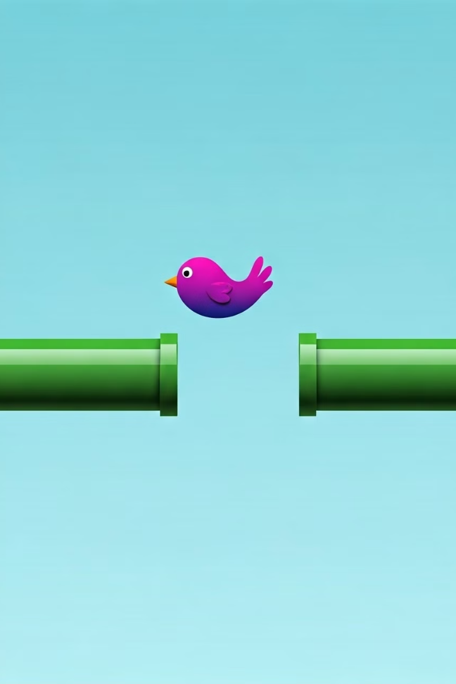




Pipe and Obstacle Handling
Pipe Generation
Create new pipe pairs at random intervals to constantly challenge the player.
Pipe Movement
Move the pipes horizontally from right to left across the screen, creating a sense of urgency and speed.
Pipe Gap
Set the height of the gap between the pipes, creating different levels of difficulty based on the size of the opening.
Offscreen Removal
Remove pipes that have moved off-screen to maintain efficiency and prevent clutter.

Slide 8
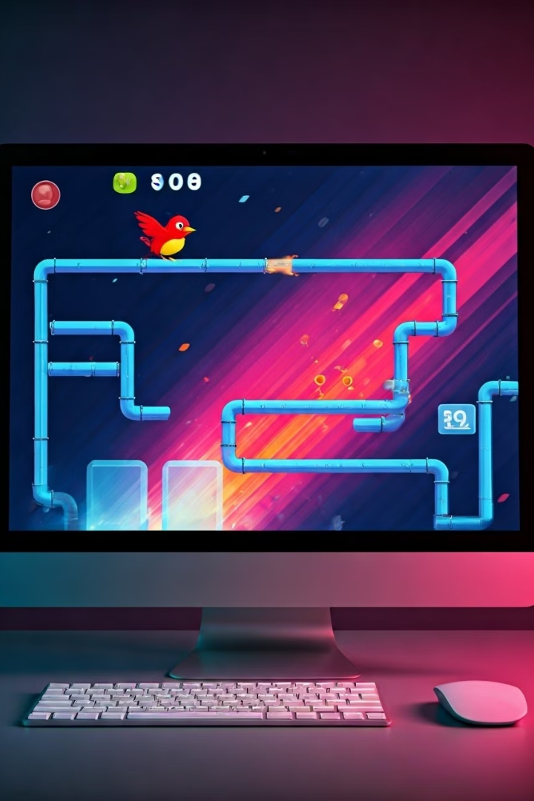




Game Loop and Event Handling
Game Loop
Key Listener
Continuously update the game state, redrawing the graphics and handling events.
Respond to keyboard presses, primarily the space bar for the bird's flap action.
Timer
Collision Detection
Control the game's pace and animation speed by scheduling regular updates to the game loop.
Check for collisions between the bird and obstacles during each frame of the game loop.

